Slide 1
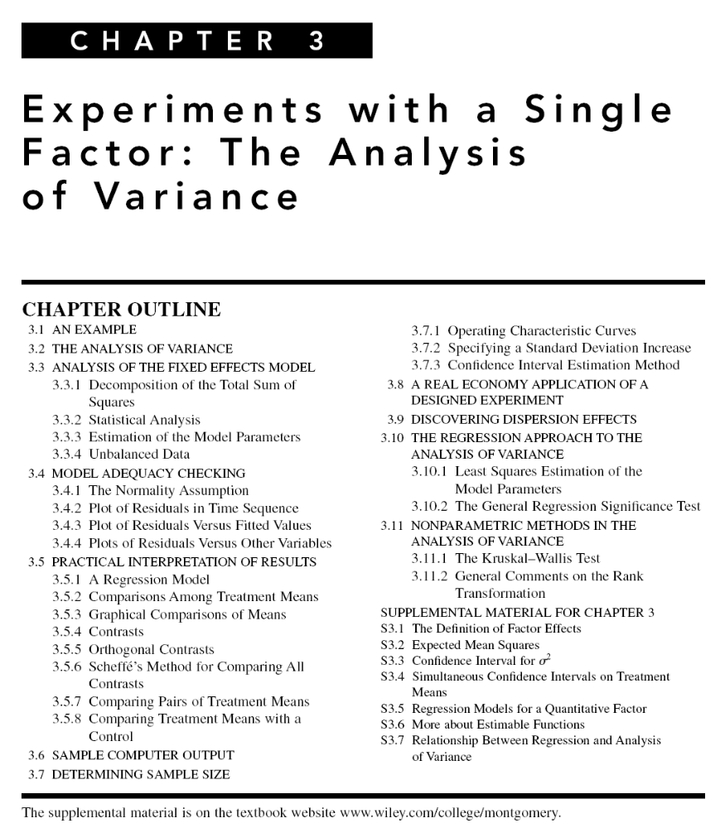

Slide 2
What If There Are More Than Two Factor Levels?
The t-test does not directly apply
There are lots of practical situations where there are either more than two levels of interest, or there are several factors of simultaneous interest
The analysis of variance (ANOVA) is the appropriate analysis “engine” for these types of experiments
The ANOVA was developed by Fisher in the early 1920s, and initially applied to agricultural experiments
Used extensively today for industrial experiments

Slide 3
An Example (See pg. 61)
An engineer is interested in investigating the relationship between the RF power setting and the etch rate for this tool. The objective of an experiment like this is to model the relationship between etch rate and RF power, and to specify the power setting that will give a desired target etch rate.
The response variable is etch rate.
She is interested in a particular gas (C2F6) and gap (0.80 cm), and wants to test four levels of RF power: 160W, 180W, 200W, and 220W. She decided to test five wafers at each level of RF power.
The experimenter chooses 4 levels of RF power 160W, 180W, 200W, and 220W
The experiment is replicated 5 times – runs made in random order

Slide 4
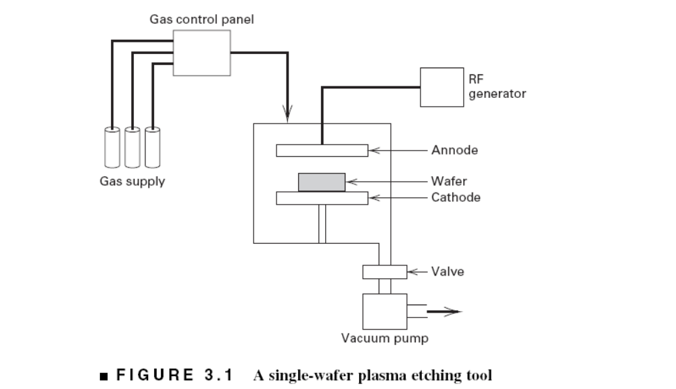

Slide 5
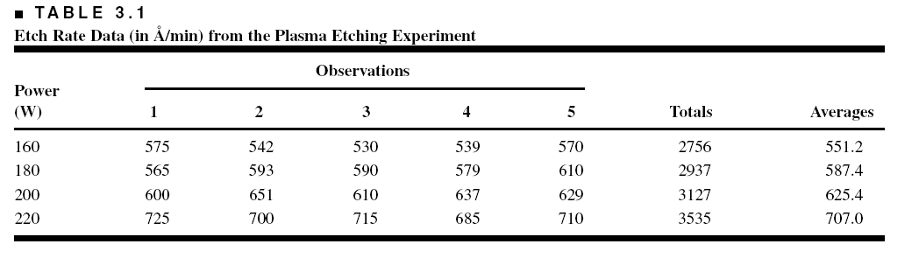
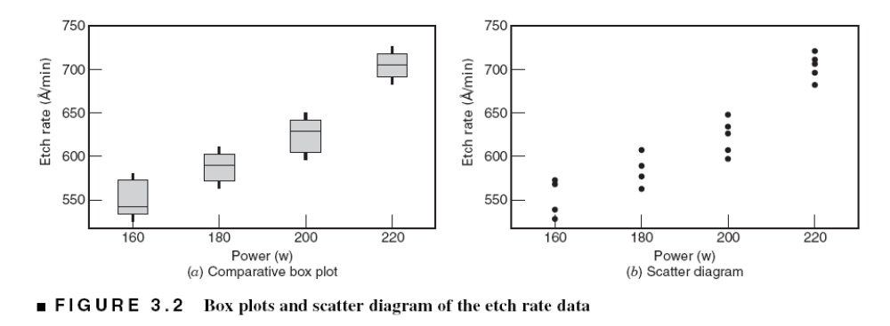
An Example (See pg. 62)

Slide 6
Does changing the power change the mean etch rate?
Is there an optimum level for power?
We would like to have an objective way to answer these questions
The t-test really doesn’t apply here – more than two factor levels

Slide 7
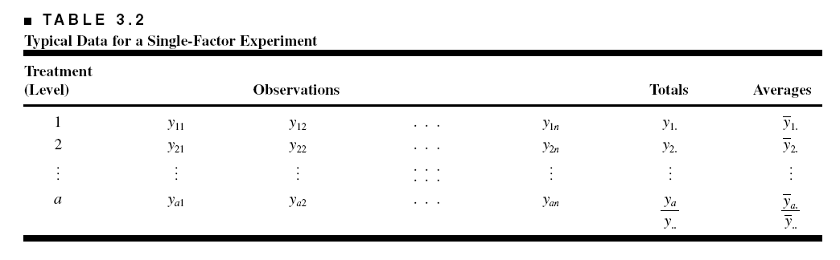
The Analysis of Variance (Sec. 3.2, pg. 62)
In general, there will be a levels of the factor, or a treatments, and n replicates of the experiment, run in random order…a completely randomized design (CRD)
N = an total runs
We consider the fixed effects case…the random effects case will be discussed later
Objective is to test hypotheses about the equality of the a treatment means

Slide 8
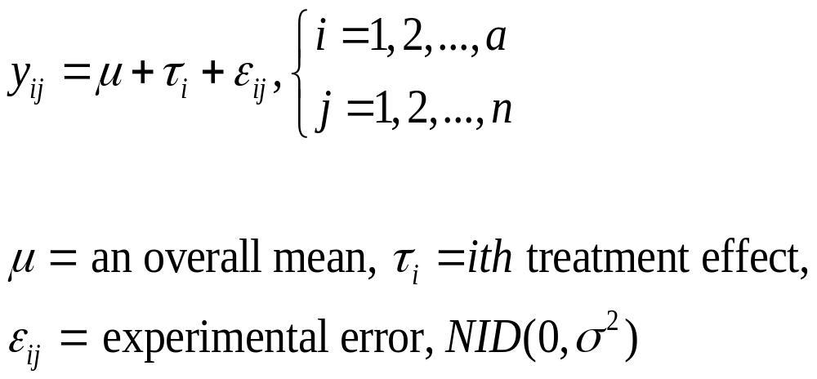
The Analysis of Variance
The name “analysis of variance” stems from a partitioning of the total variability in the response variable into components that are consistent with a model for the experiment
The basic single-factor ANOVA model is

Slide 9
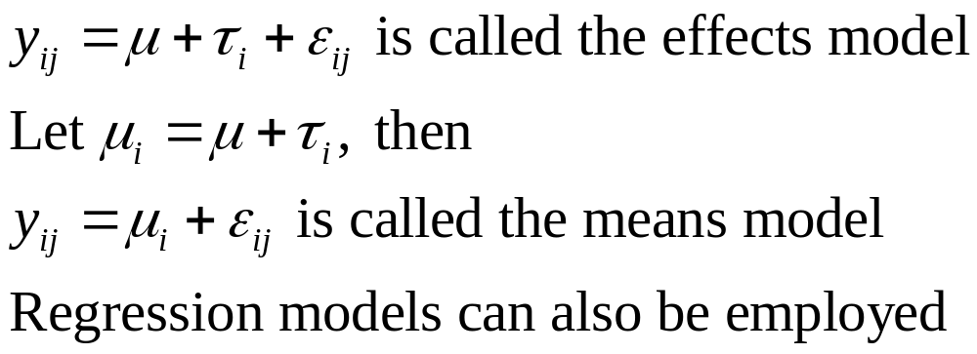
Models for the Data
There are several ways to write a model for the data:

Slide 10
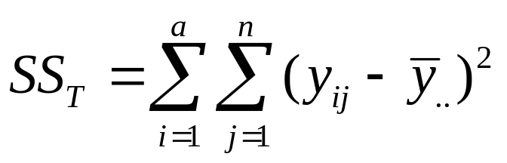
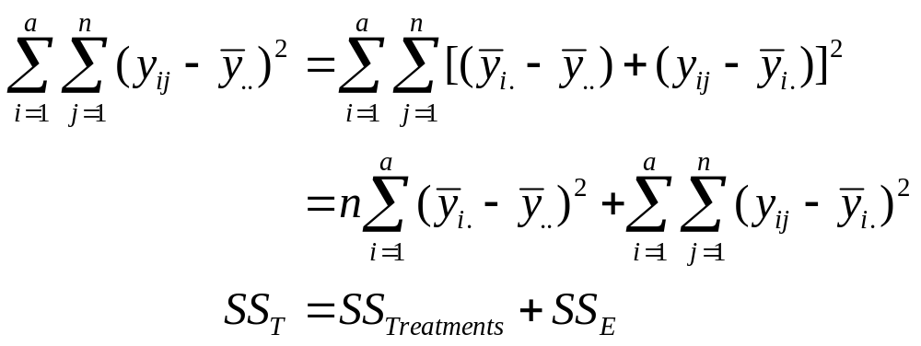
The Analysis of Variance
Total variability is measured by the total sum of squares:
The basic ANOVA partitioning is:

Slide 11
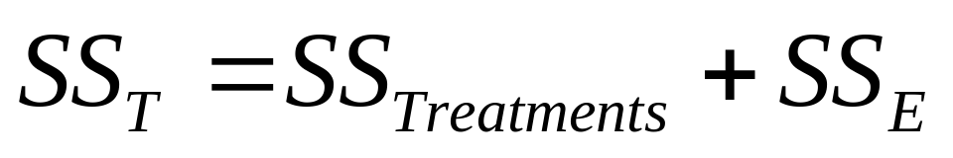
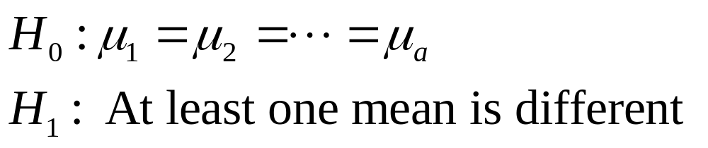
The Analysis of Variance
A large value of SS_{Treatments} reflects large differences in treatment means
A small value of SS_{Treatments} likely indicates no differences in treatment means
Formal statistical hypotheses are:

Slide 12
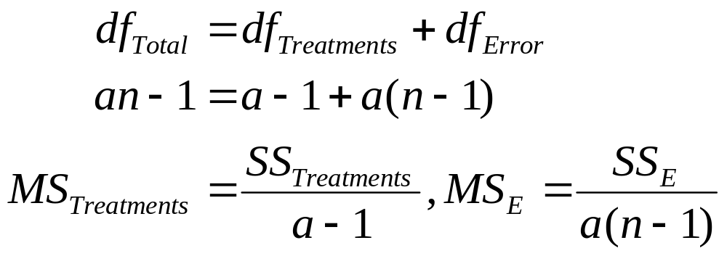
The Analysis of Variance
While sums of squares cannot be directly compared to test the hypothesis of equal means, mean squares can be compared.
A mean square is a sum of squares divided by its degrees of freedom:
If the treatment means are equal, the treatment and error mean squares will be (theoretically) equal.
If treatment means differ, the treatment mean square will be larger than the error mean square.

Slide 13
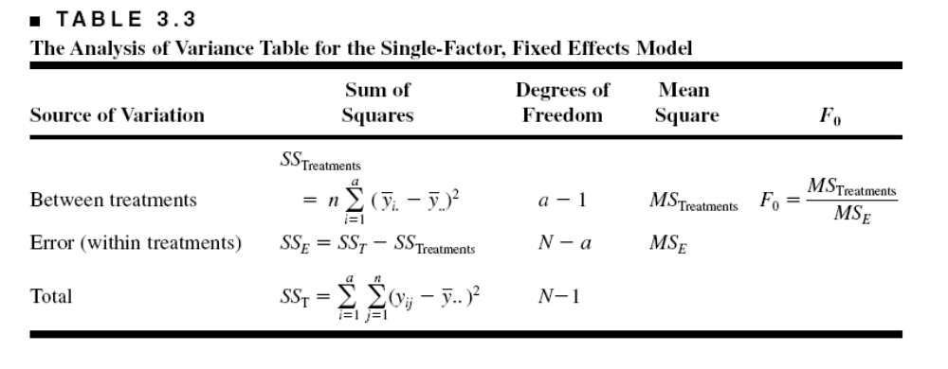

The Analysis of Variance is Summarized in a Table
Computing…see text, pp 69
The reference distribution for F₀ is the F_{a-1, a(n-1)} distribution
Reject the null hypothesis (equal treatment means) if

Slide 14
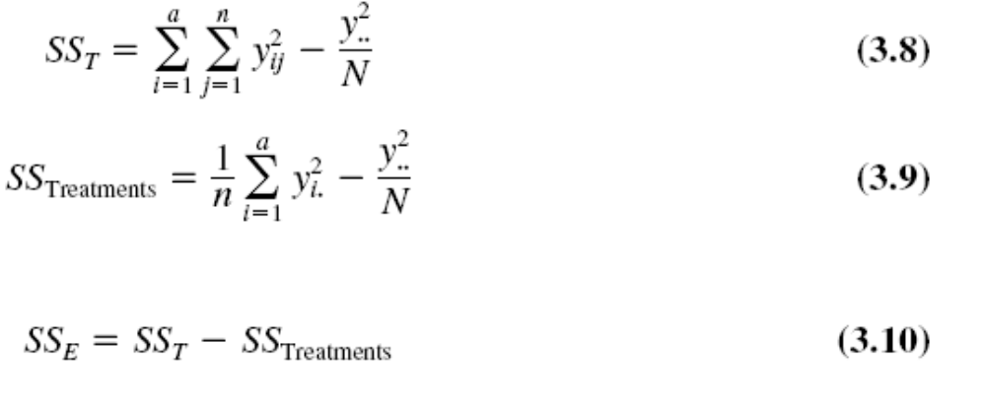

Slide 15
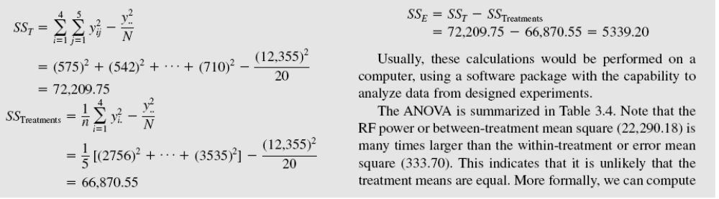
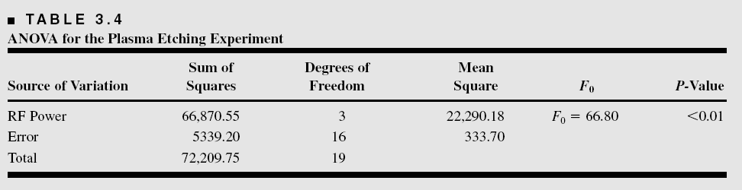
ANOVA Table
Example 3-1

Slide 16
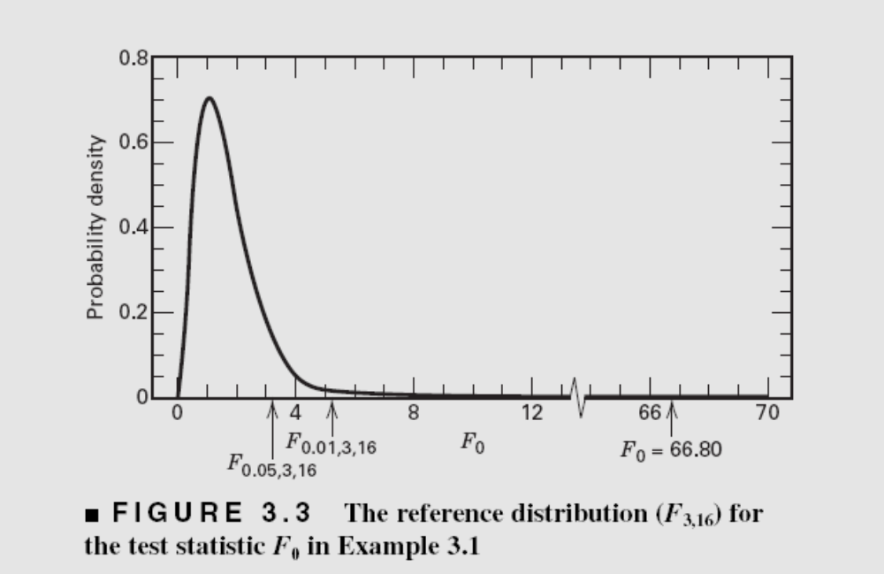
The Reference Distribution:
P-value

Slide 17
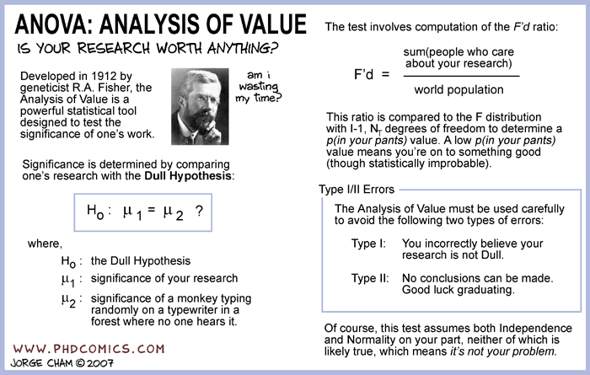
A little (very little) humor…

Slide 18
ANOVA calculations are usually done via computer
Text exhibits sample calculations from three very popular software packages, Design-Expert, JMP and Minitab
See pages 98-100
Text discusses some of the summary statistics provided by these packages

Slide 19
Model Adequacy Checking in the ANOVA
Text reference, Section 3.4, pg. 75
Checking assumptions is important
Normality
Constant variance
Independence
Have we fit the right model?
Later we will talk about what to do if some of these assumptions are violated

Slide 20
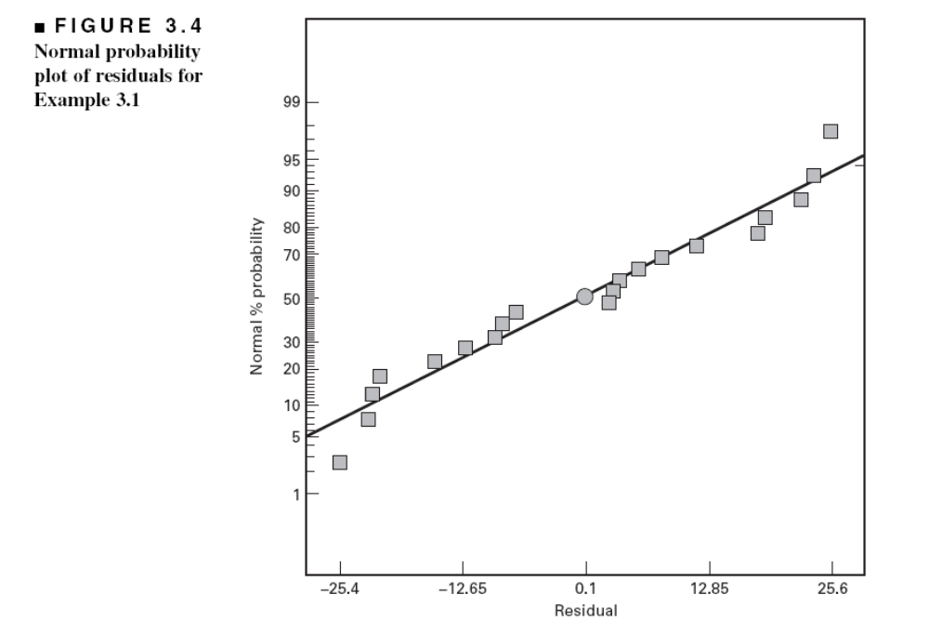
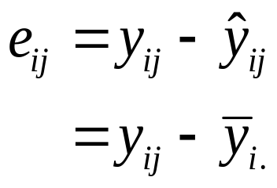
Model Adequacy Checking in the ANOVA
Examination of residuals (see text, Sec. 3-4, pg. 75)
Computer software generates the residuals
Residual plots are very useful
Normal probability plot of residuals

Slide 21
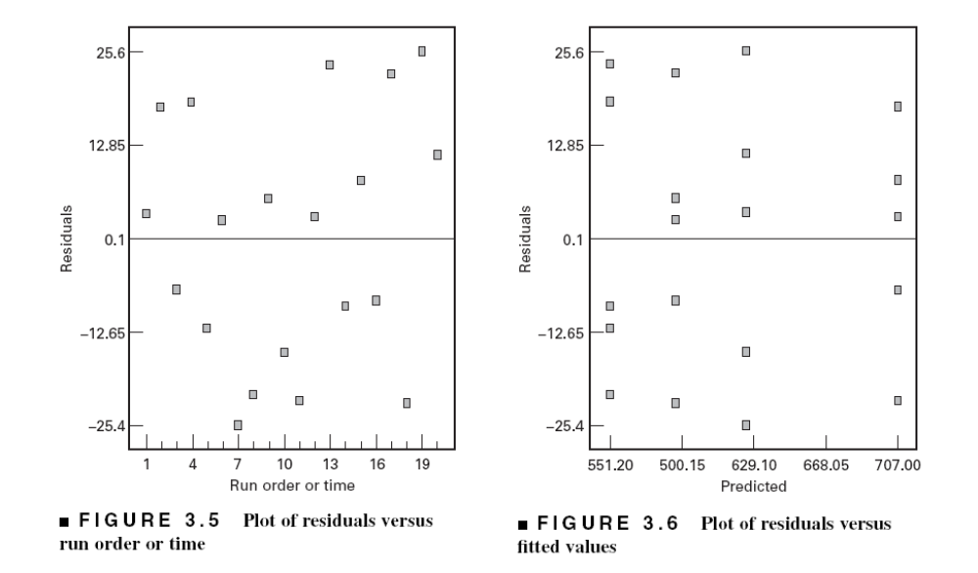
Other Important Residual Plots

Slide 22
Post-ANOVA Comparison of Means
The analysis of variance tests the hypothesis of equal treatment means
Assume that residual analysis is satisfactory
If that hypothesis is rejected, we don’t know which specific means are different
Determining which specific means differ following an ANOVA is called the multiple comparisons problem
There are lots of ways to do this…see text, Section 3.5, pg. 84
We will use pairwise t-tests on means…sometimes called Fisher’s Least Significant Difference (or Fisher’s LSD) Method

Slide 23
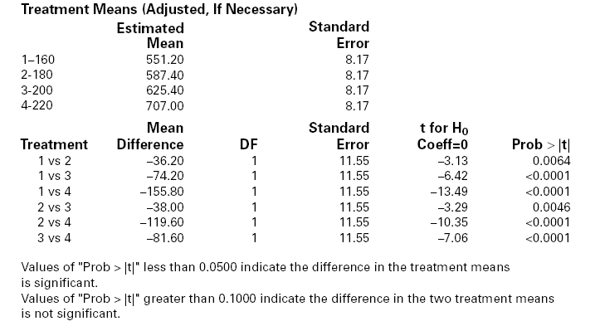
Design-Expert Output

Slide 24
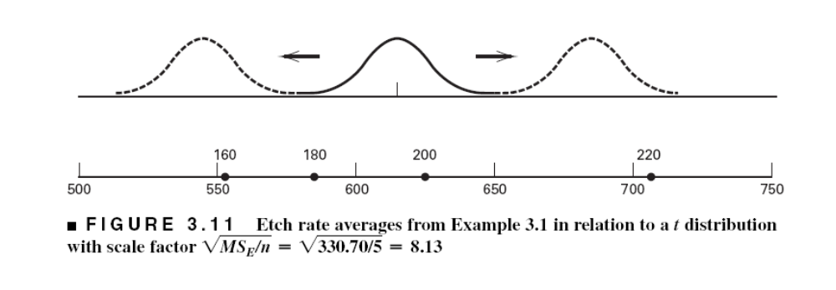
Graphical Comparison of Means
Text, pg. 88

Slide 25

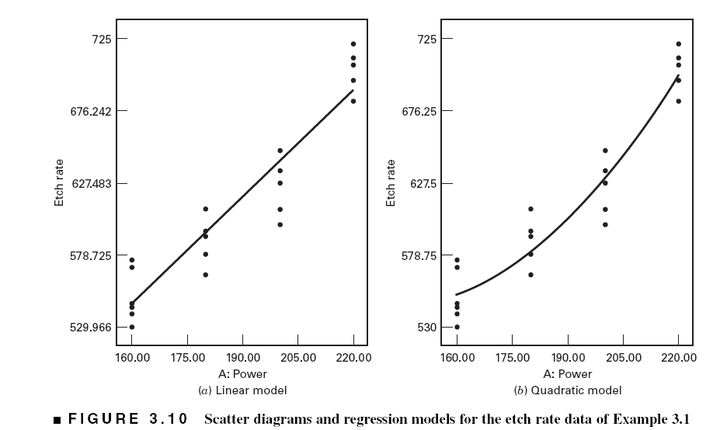
The Regression Model

Slide 26
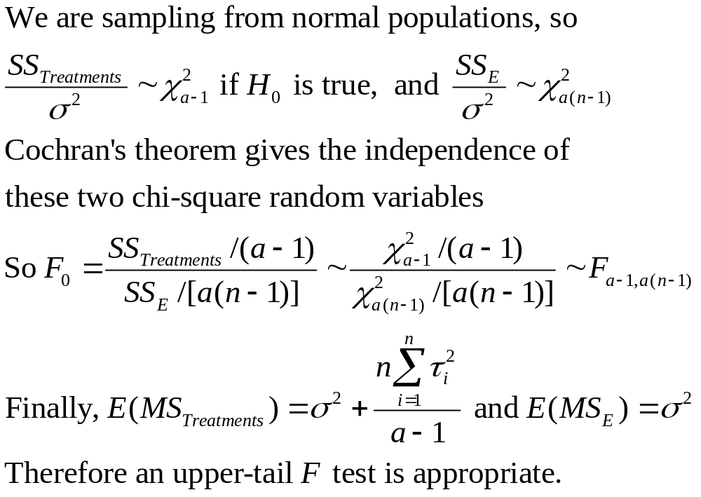
Why Does the ANOVA Work?

Slide 27
Sample Size Determination
Text, Section 3.7, pg. 101
FAQ in designed experiments
Answer depends on lots of things; including what type of experiment is being contemplated, how it will be conducted, resources, and desired sensitivity
Sensitivity refers to the difference in means that the experimenter wishes to detect
Generally, increasing the number of replications increases the sensitivity or it makes it easier to detect small differences in means

Slide 28



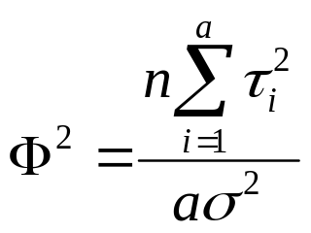
Sample Size Determination
Fixed Effects Case
Can choose the sample size to detect a specific difference in means and achieve desired values of type I and type II errors
Type I error – reject H₀ when it is true ( )
Type II error – fail to reject H₀ when it is false ( )
Power = 1 -
Operating characteristic curves plot against a parameter where

Slide 29

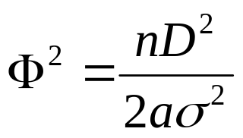

Sample Size Determination
Fixed Effects Case---use of OC Curves
The OC curves for the fixed effects model are in the Appendix, Table V
A very common way to use these charts is to define a difference in two means D of interest, then the minimum value of is
Typically work in term of the ratio of and try values of n until the desired power is achieved
Most statistics software packages will perform power and sample size calculations – see page 103
There are some other methods discussed in the text

Slide 30
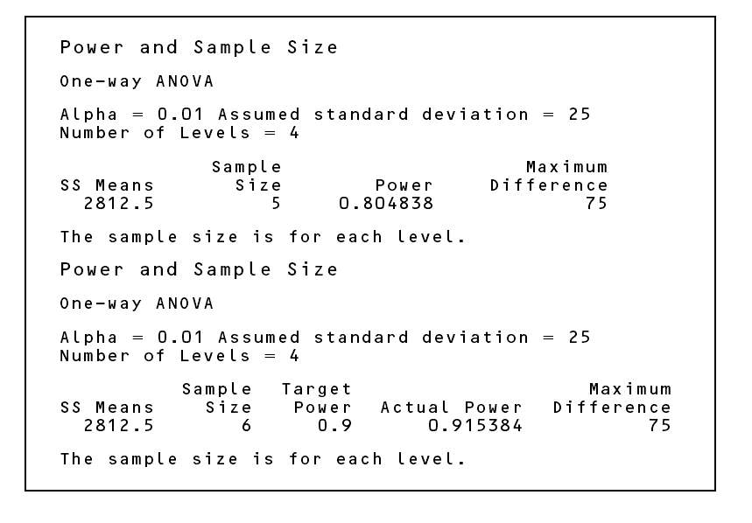
Power and sample size calculations from Minitab (Page 103)

